Slide 1



AWS Deployment
EC2 & S3

Slide 2

Agenda
Cloud Services
Use Cases
EC2 & S3
Further possibilities
© 2019, Amazon Web Services, Inc. or its affiliates. All rights reserved.

Slide 3
Why AWS?
Cloud service:
Greater agility and flexibility
Low-cost
Quickly test the effectiveness of new solutions
Unlimited storage
Security
Disaster prevention
Less things to worry about!
© 2019, Amazon Web Services, Inc. or its affiliates. All rights reserved.

Slide 4
Why AWS?
Amazon Web Service:
Globally based
Owns a dominant 34% of all cloud
Reliability
SDK Can be used
© 2019, Amazon Web Services, Inc. or its affiliates. All rights reserved.

Slide 5
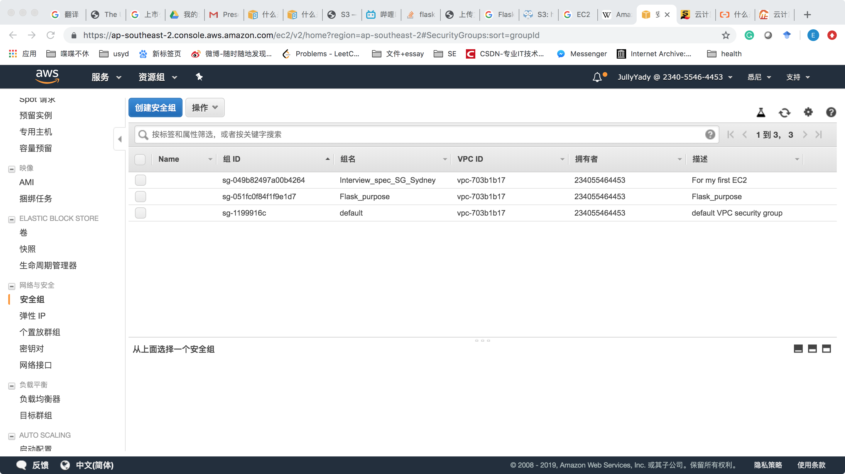
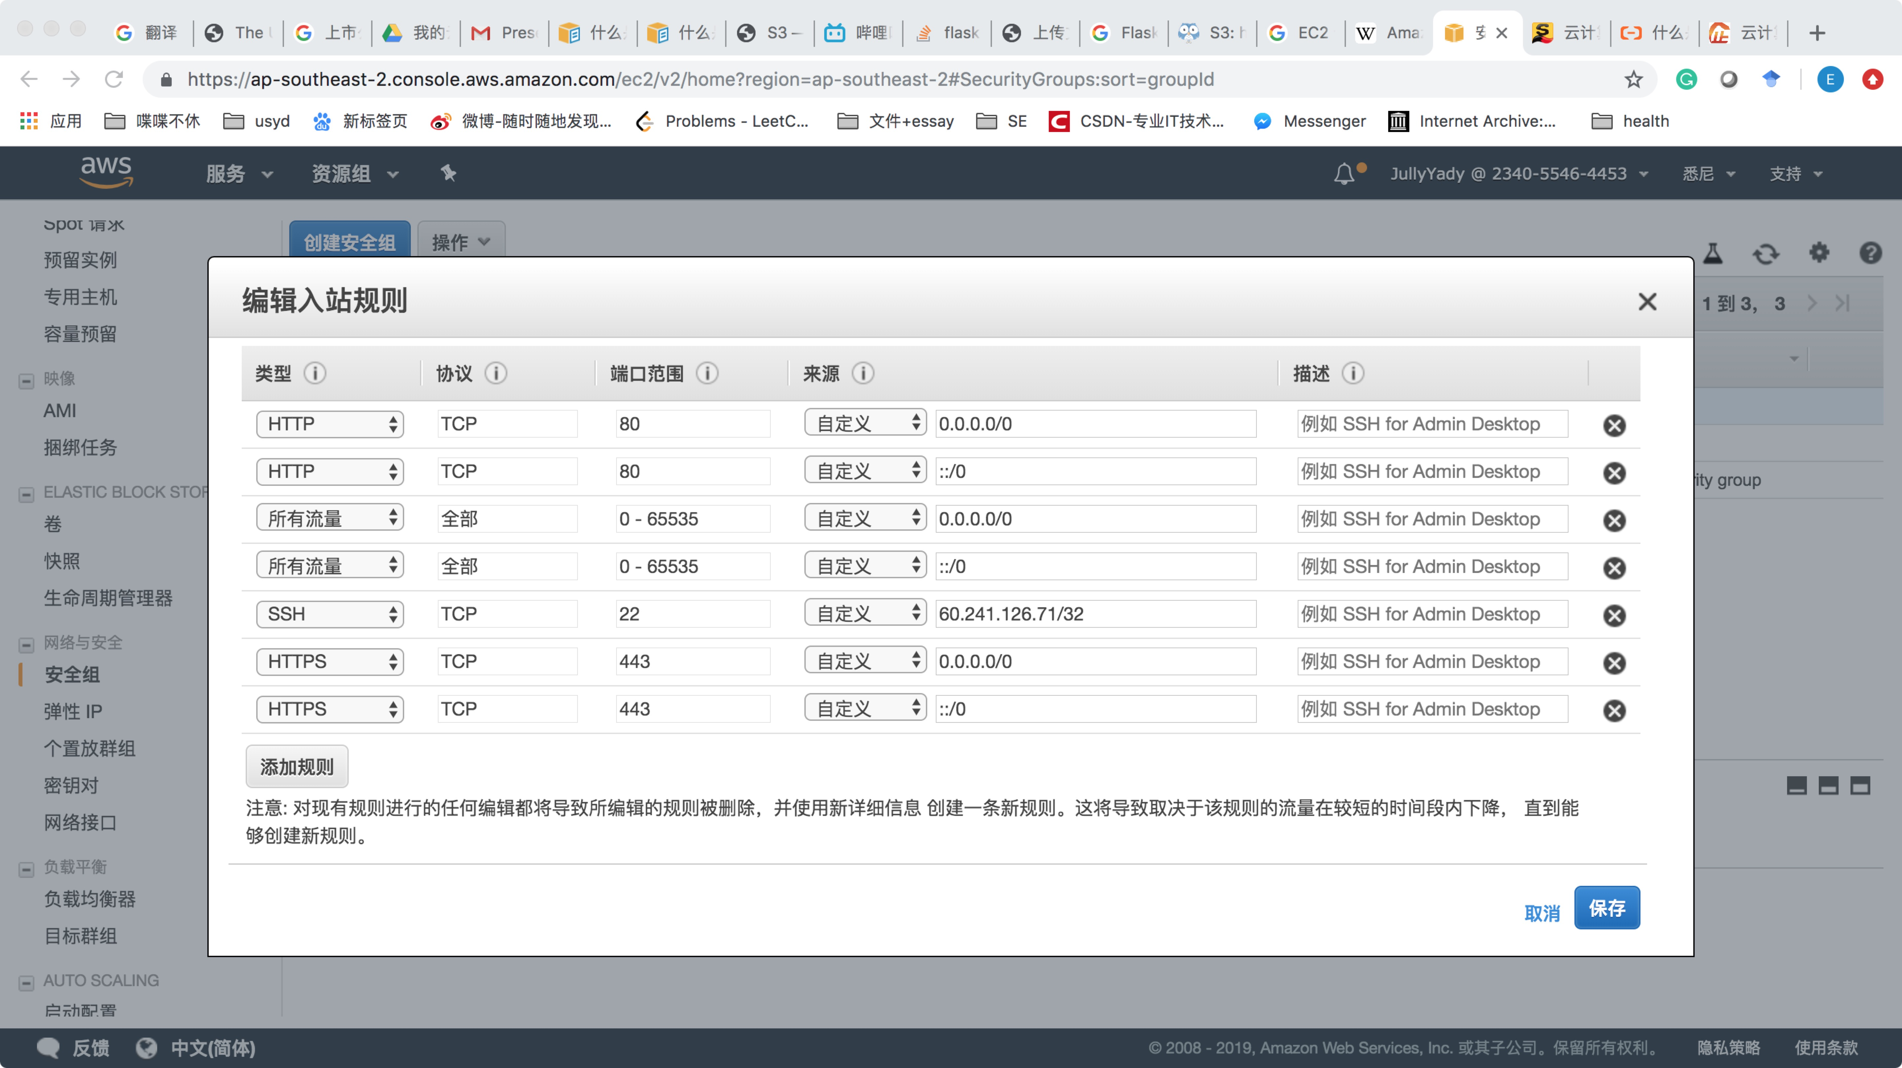
EC2 : Amazon Elastic Compute Cloud
Virtual computers
Run our own computer applications
Pre-Configure using AMI for the actual instance
Security
Firewall can be configured easily
© 2019, Amazon Web Services, Inc. or its affiliates. All rights reserved.

Slide 6
EC2 : Amazon Elastic Compute Cloud
Benefit:
Fast Deployment
Low Price & High performance
Supply by needs
Location & IP address
Time
A huge variety choices of OS
Multiple software application
Tangible Cost reduction!
© 2019, Amazon Web Services, Inc. or its affiliates. All rights reserved.

Slide 7

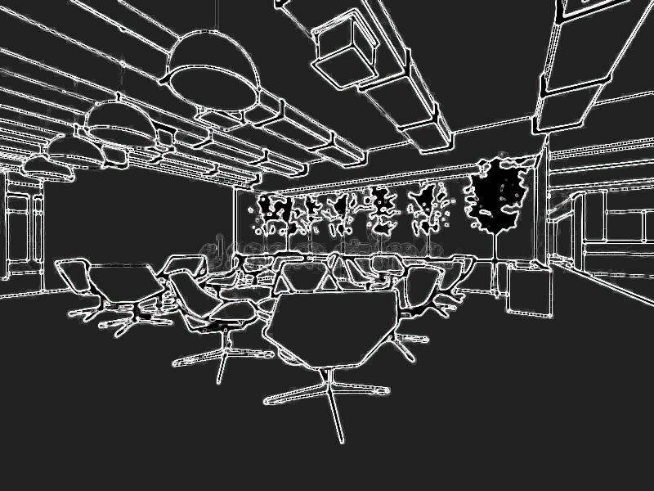
EC2 : Amazon Elastic Compute Cloud
Benefit (VPC):
Better management
Resources assignment/access
In/out policy
Fixed IP address
Run-time security group change
© 2019, Amazon Web Services, Inc. or its affiliates. All rights reserved.

Slide 8
EC2 : Amazon Elastic Compute Cloud
Demo
© 2019, Amazon Web Services, Inc. or its affiliates. All rights reserved.

Slide 9

S3 : Simple Storage Service
Cloud storage
Huge space
Object-based storage
Objects up to 5 TB in size acceptable
Reasonable charge
© 2019, Amazon Web Services, Inc. or its affiliates. All rights reserved.

Slide 10
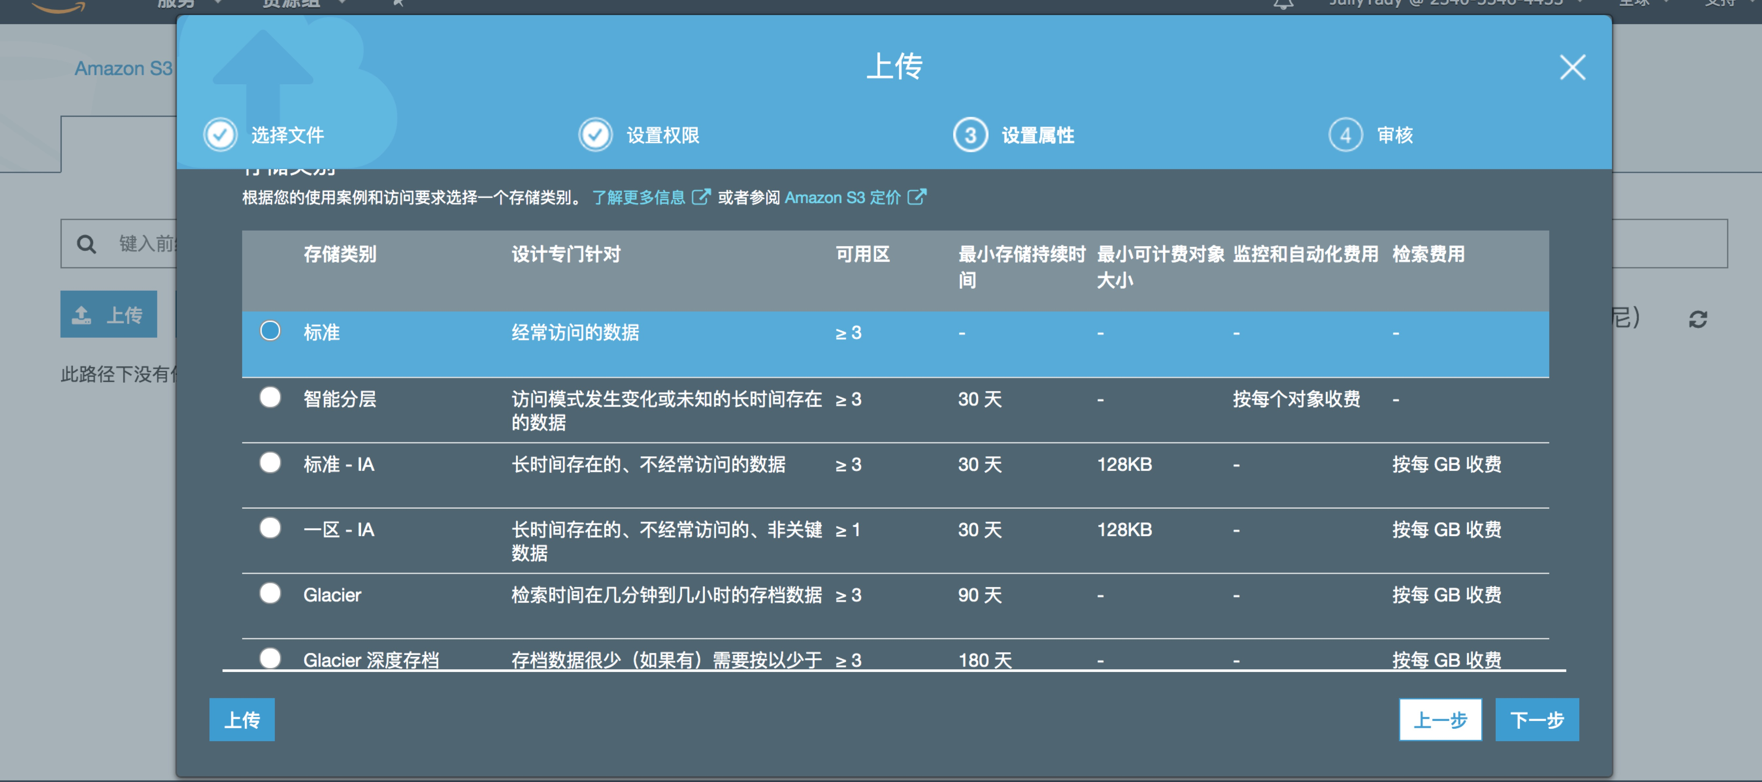
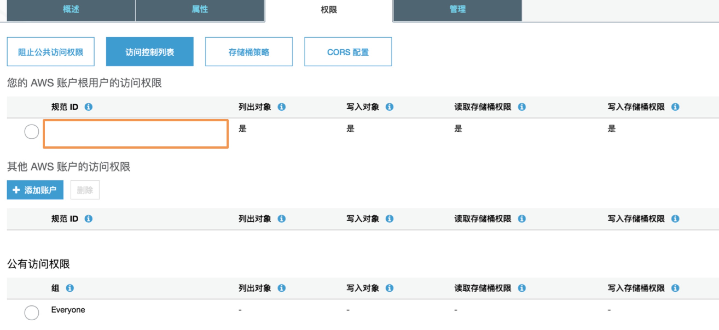
S3 : Simple Storage Service
Security:
ACL
MFA
Encryption at rest and in transit

Slide 11
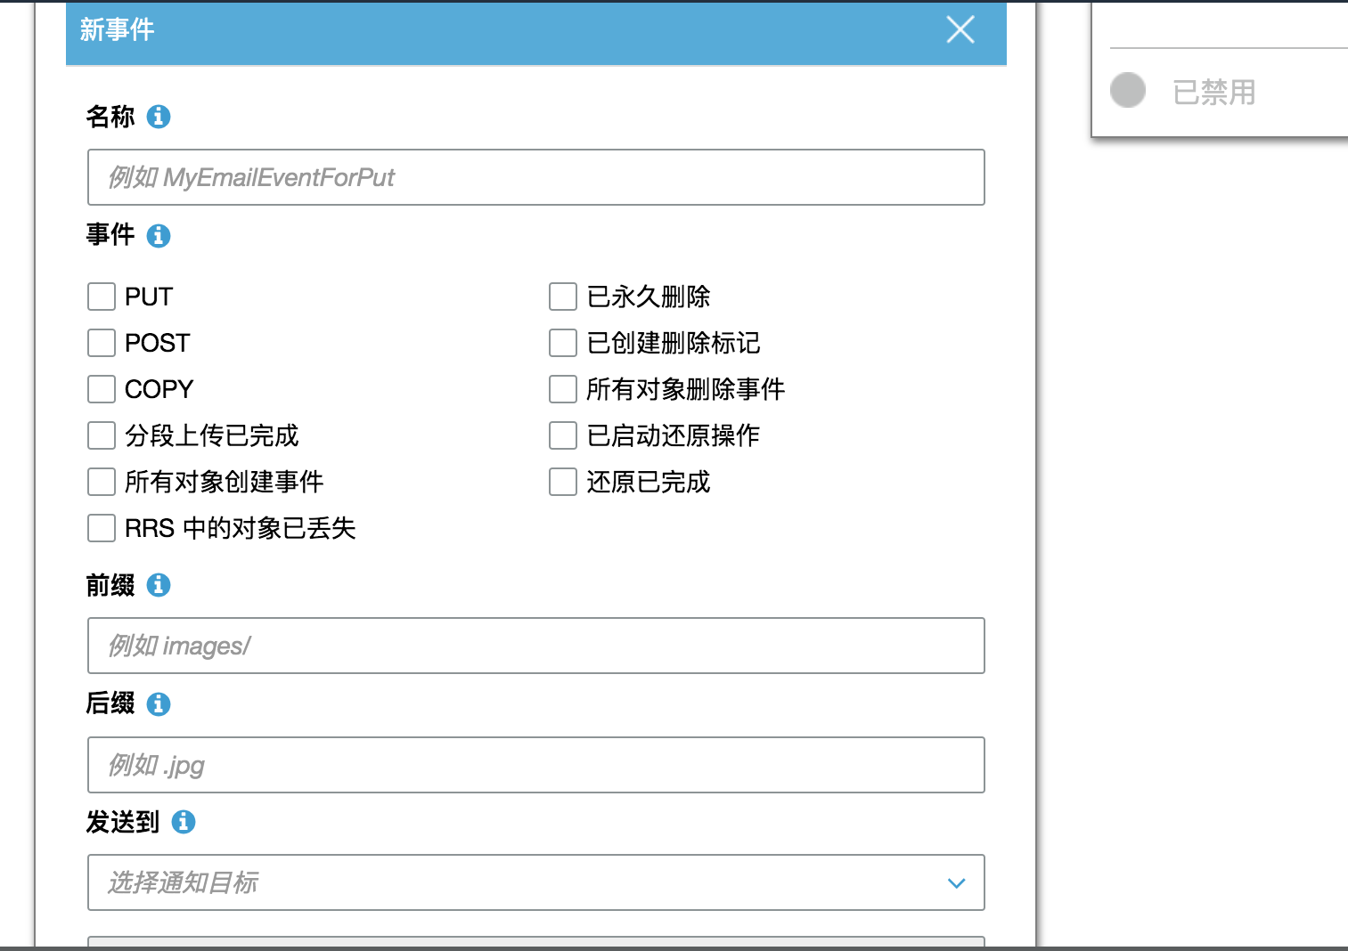
S3 : Simple Storage Service
Version control
Logging
Remote access(with access control configured)
Notification

Slide 12
S3 : Simple Storage Service
Demo
© 2019, Amazon Web Services, Inc. or its affiliates. All rights reserved.

Slide 13





S3 : Simple Storage Service
Integration
AWS Cloud
Amazon S3 output bucket
End users
AWS CloudTrail
IAM admin
Amazon Simple Notification Service
AWS Lambda
© 2019, Amazon Web Services, Inc. or its affiliates. All rights reserved.

Slide 14





Next Step
More services
More integration
Machine learning, IoT …
AWS IoT Device Management
AWS IoT Core
Amazon SageMaker
AWS IoT Button
AWS IoT Events
© 2019, Amazon Web Services, Inc. or its affiliates. All rights reserved.

Slide 15
Thank You for listening

